Slide 1






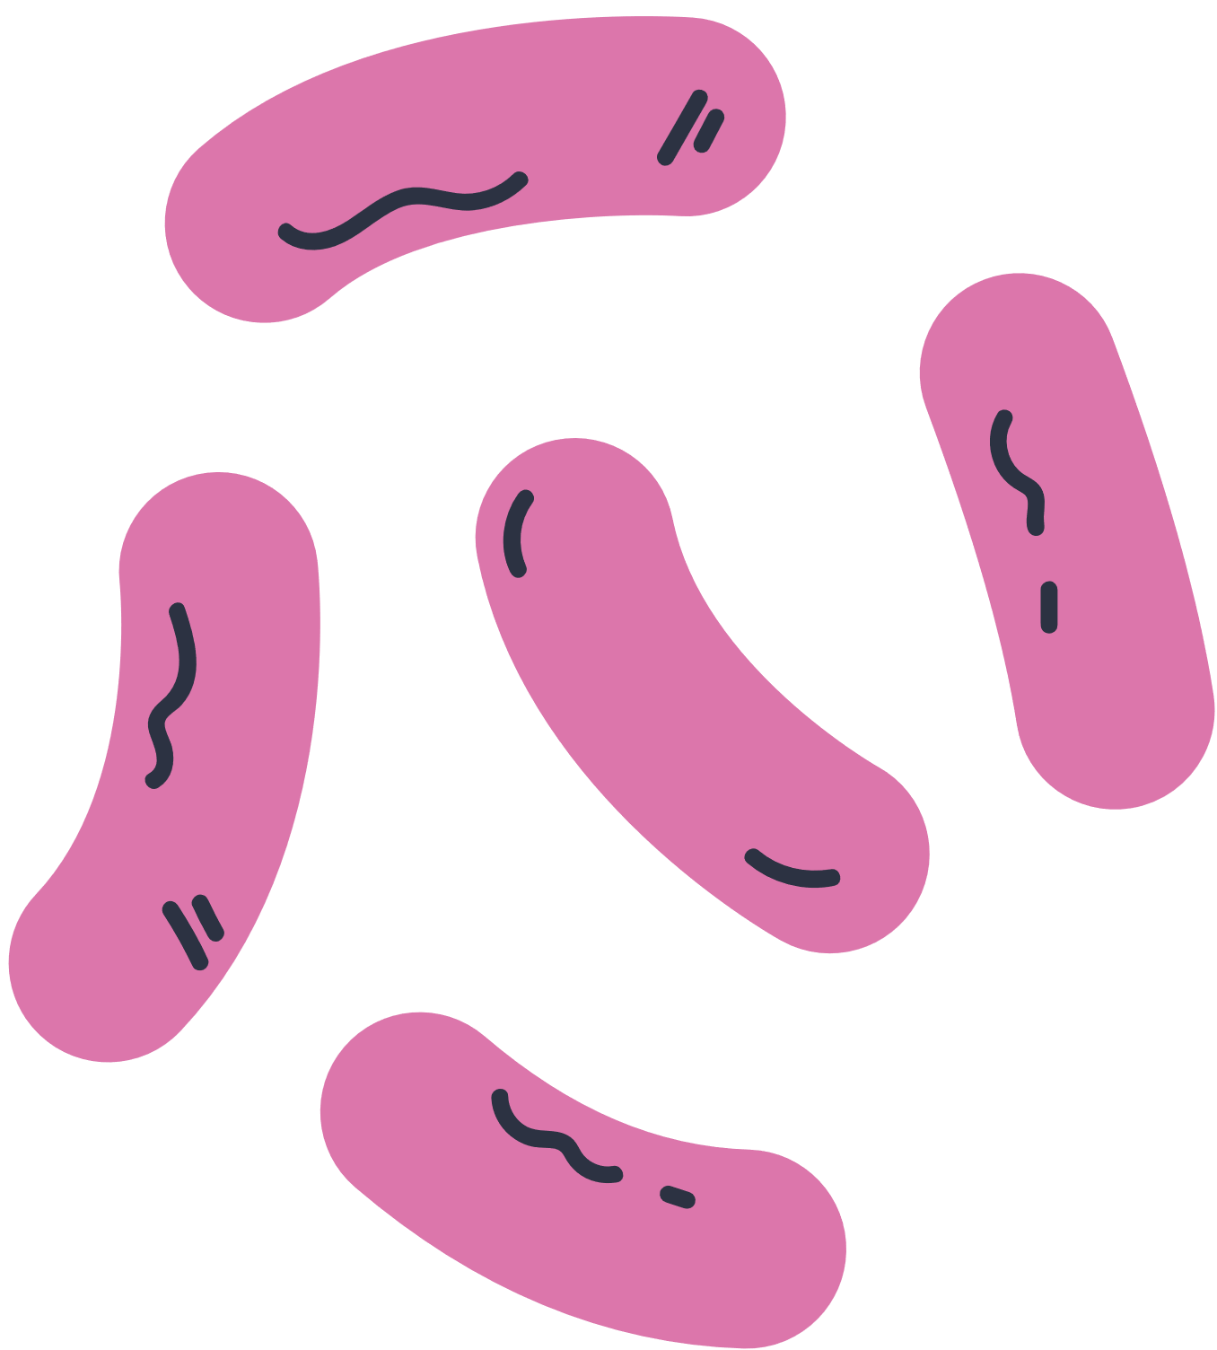
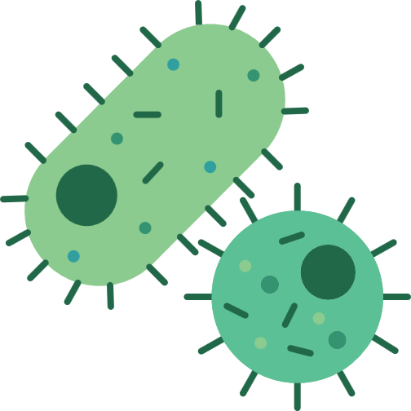



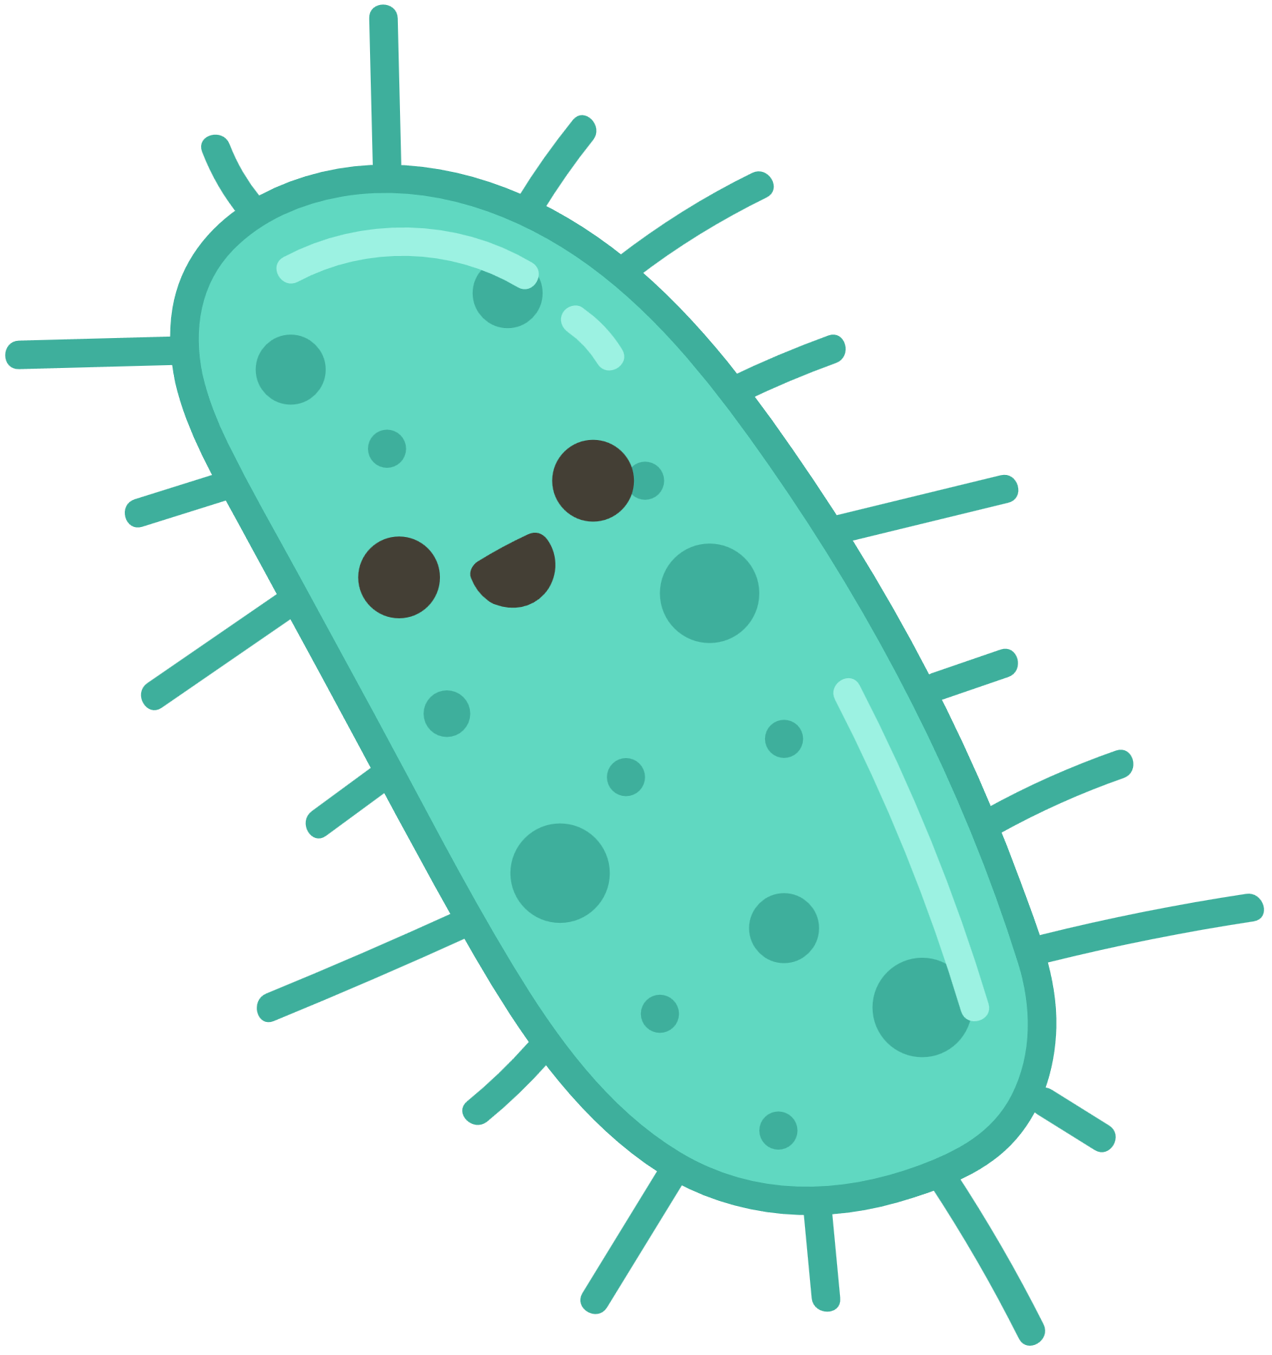



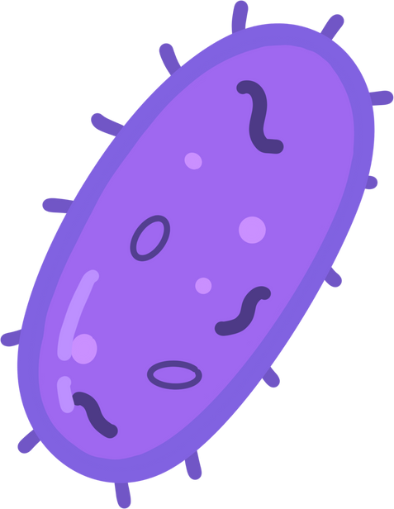

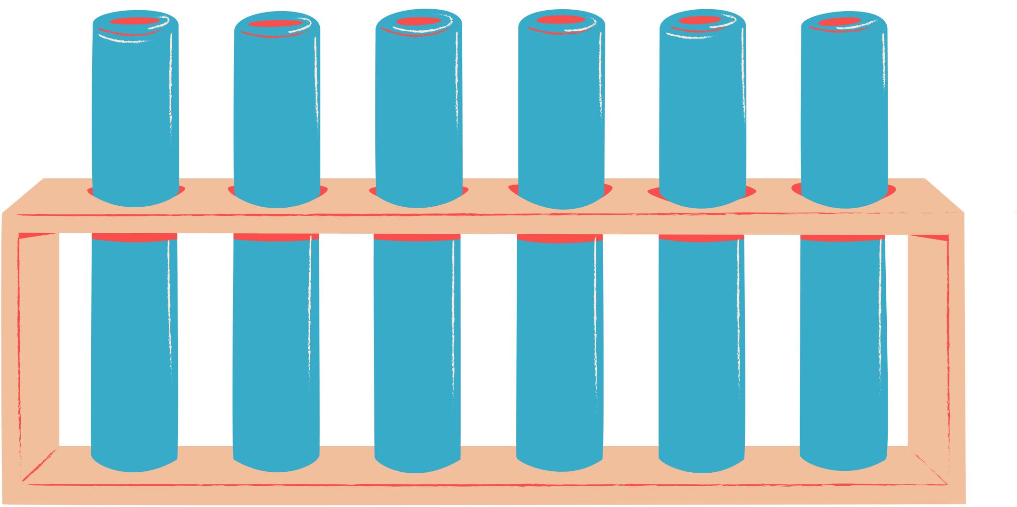





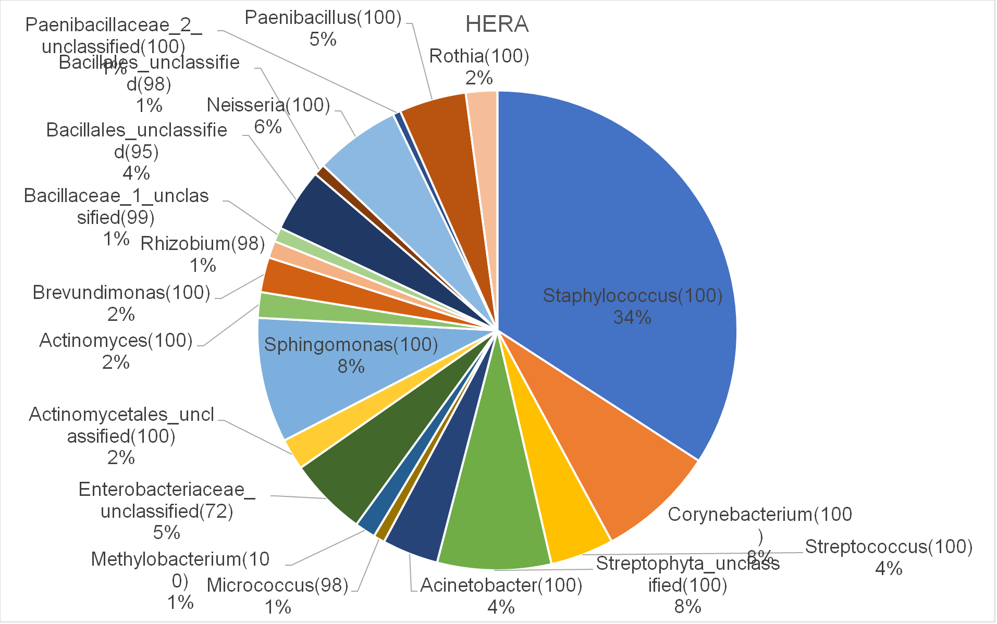
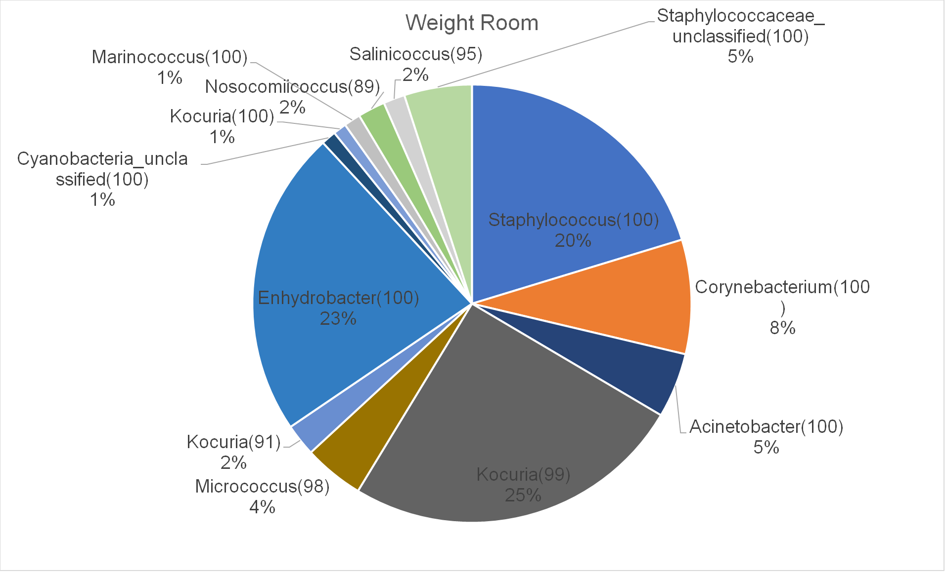
Antibiotics and Beyond: Investigating microbial community dynamics in response to topical treatments
Amarnath, James Novak
BACKGROUND
EXPERIMENTAL SETUP
IMPACT
Antibiotic resistance has emerged as a global crisis due to the overuse, misuse, and misapplication of antibiotics (Davies and Davies, 2010). According to the Centers for Disease Control and Prevention, More than 2.8 million antimicrobial-resistant infections occur in the U.S. each year. Our project focuses on the effect of topical antibiotics on bacterial communities, aiming to understand the community change when using specific antibiotic cleaners compared to water and dry wiping. Hospitals and organizations are interested in tracking and mitigating bacterial contamination on surfaces (Rawlinson et al., 2019; Verdier et al., 2014). Understanding the stability and robustness of bacterial communities is crucial in addressing the antibiotic resistance crisis and developing effective protocols (Pearson et al., 2018).
Amidst the pressing concern of over 2.8 million antimicrobial-resistant infections occurring in the US each year, our research takes on a critical role. This research carries significant implications for various environments, including hospitals, space stations, and other settings that rely on antibacterial sprays and cleaning practices to maintain hygienic surfaces.
By studying resistance mechanisms within bacterial communities, we have the potential to develop tailored strategies to mitigate negative effects. By enhancing cleaning protocols and reducing antibiotic use, we aim to curb the spread of antibiotic-resistant diseases, potentially saving countless lives. This approach can help reduce the constant demand for new antibiotics, offering a more sustainable solution.
DRY WIPE
WATER WIPE
ANTIBACTERIAL WIPE
-80 ° C
RESEARCH GOALS
DISCUSSION
Quantify the community change caused by topical antibiotics compared to water and dry wiping
Establish protocols to minimize the use of topical antibiotics and reduce antibiotic resistance evolution
Contribute to a broader ecological perspective in combating the global antibiotic resistance crisis
16s rRNA
Isolation PCR
Our research contributes to the understanding of antibiotic resistance development and its implications for bacterial communities. The study highlights the importance of considering the stability and robustness of bacterial communities rather than focusing solely on specific taxa. By investigating the impact of topical antibiotics on bacterial community structure, we aim to develop techniques that can reduce the rate of antibiotic resistance development. This research challenges the conventional approach of eliminating bacteria and emphasizes the need to mitigate negative effects when necessary.
DNA
Isoaltion
Analysis
Using R
METHODS
ANTICIPATED RESULTS
The experimental setup involves using 4.25" square ceramic tiles as the surface for bacterial colonization (Verdier et al., 2014). Thirty tiles are grouped into three sets of 10. Each set of tiles undergoes one of three treatments: dry wiped, water wiped, or CaviCideä wiped using sterile wipes. Swab samples are taken using sterile swipes and stored in sterile culture tubes at -80°C, the process is repeated every week for six weeks. DNA extraction follows the procedures by Hladilek et al. (2016), with amplification of the 16s rRNA gene using PCR and sequencing. Data analysis employs the Mothur Pipeline (Schloss and Wescott, 2011) and R Statistical Programming language with bioinformatics packages to assign taxa designations and analyze bacterial communities.
In our forthcoming analysis, we anticipate parallels between the bacterial compositions in our laboratory and NASA's HERA and Weight room. This expectation is based on shared traits: controlled environments, stringent cleanliness measures, and human activity. These factors create similar conditions that foster microbial colonization.
ACKNOWLEDGEMENTS
I would like to express my gratitude to the university and the Undergraduate Research Department for their generous support and funding, which have been essential in making this research possible. I am also thankful for the invaluable guidance and support provided by Dr. Novak (mentor) throughout this research project.

